Slide 1

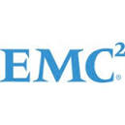
My Capstone at
ClientTrack & EMC Corporation
Deepti Deshpande
u0872493

Slide 2
About ClientTrack
  ClientTrack software and professional services advance the missions of Health, Human and Social Service organizations by enhancing their ability to gather, use and report client information.
  ClientTrack is the industry’s only software that fully supports the efforts to establish organizational best practices through improved efficiency, optimize collaborations within and between organizations, ensure compliance with funding sources and enhance outcomes reporting to strengthen fundraising and build community awareness.

Slide 3
Project Tasks
Role
Software Engineer Intern
Tasks
Understand the ClientTrack value chain and social impact
Learn how to integrate a new organization in the ClientTrack software
Develop reports for the new and existing organization
Resolve the service requests raised by the customers
Technical Skills
SQL
SQL Server Reporting Services
ClientTrack Software

Slide 4
Project Tasks
Contd..
Methods
Learn about the project and ClientTrack software by shadowing implementation engineers and development staff
Meet with business analysts to understand customer requirements
Complete all standard ClientTrack foundation training sessions available on the intranet

Slide 5
Results & Lessons Learned
Results
Integrated a new customer successfully into ClientTrack’s environment
Created internal reports for ClientTrack
Successfully handled the service requests raised by customers
Built good contacts at ClientTrack
Lessons Learned
Learned about the ClientTrack organization, their market area and how their services affect the social services organizations
Learned the SDLC at ClientTrack by understanding how the requirements are gathered, implemented and released

Slide 6
About EMC Corporation
EMC is a global leader in enabling businesses and service providers to transform their operations and deliver information technology as a service (ITaaS). Fundamental to this transformation is cloud computing.
Through innovative products and services, EMC accelerates the journey to cloud computing, helping IT departments to store, manage, protect and analyze their most valuable asset — information — in a more agile, trusted and cost-efficient way.

Slide 7
Project Overview and Tasks
Role
Data Analytics Intern
Overview & Tasks
Part of Customer Services Business Operations team of Information Intelligence Group (IIG) at EMC Corporation
IIG handles major products of EMC namely Documentum, DocSci, AX, Captiva, etc.
Responsible for designing, developing and maintaining ongoing metrics, reports, analyses, dashboards, etc., to drive key business decisions and communicate key concepts to the leadership team.

Slide 8
Project Overview & Tasks
Contd..
Create user-friendly dashboards like L2 tasks metrics, Monday morning dashboard, Individual Contributor Metrics, Root Cause Analysis, Backlog Manager to drive key business decisions and communicate area of focus to the engineers and managers to efficiently manage the service requests.
Technical Skills
SQL
Tableau Desktop 8.1
Greenplum Database

Slide 9
L2 Project Objective & Tasks
Objective
Generate a L2 (Second level support) dashboard which has metrics like backlogs, number of Service Requests (SR) created/closed, archived data for a specified time period
Tasks
Gather requirements from project managers and Geo leads of various regions who manage L2 engineers. L2 engineers would be SME or DSE.
Identify data in the Greenplum on the basis of collected requirements
Generate data extracts by writing queries and automate their generation on a daily basis

Slide 10
L2 Project Tasks Contd..
Use Tableau to generate various metrics from the data extracted from Greenplum
Conduct meetings with different regions like EMEA, APJ, NA etc. to present the reports and how to use them

Slide 11
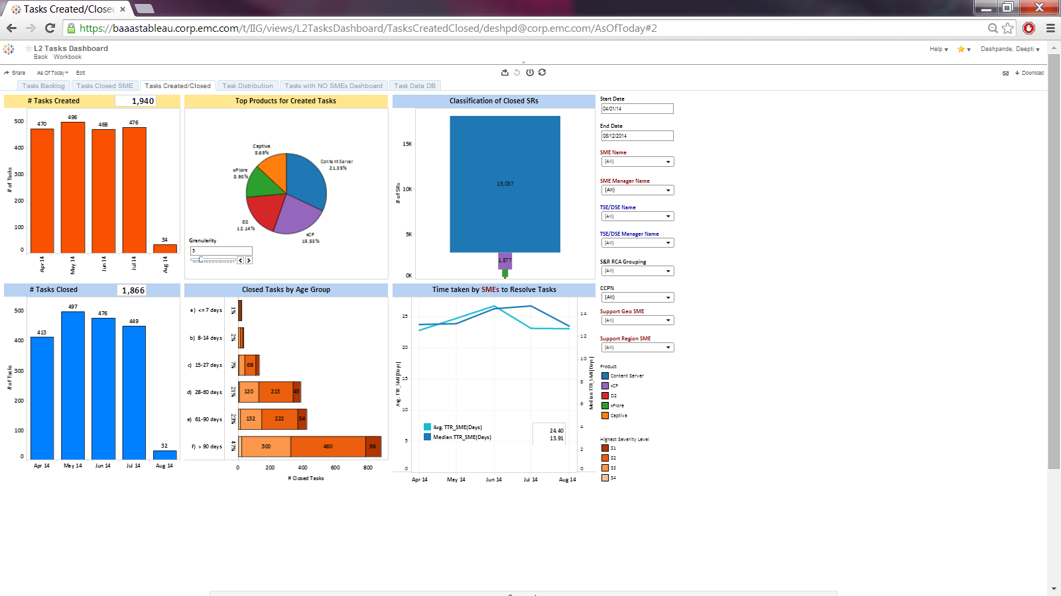
L2 Tasks Dashboard

Slide 12
Manager Hotlist Project Objective & Tasks
Objective
Generate a manager hotlist dashboard which highlights the critical SRs to the managers and indicates the reason of its criticality
Tasks
Identify data in the Greenplum on the basis of gathered requirements from the leadership team
Generate data extracts by writing queries and automate their generation on a daily basis
Use Tableau to generate the dashboard and highlight the reason for the SR’s criticality
Schedule the reports so that managers receive them every Monday

Slide 13
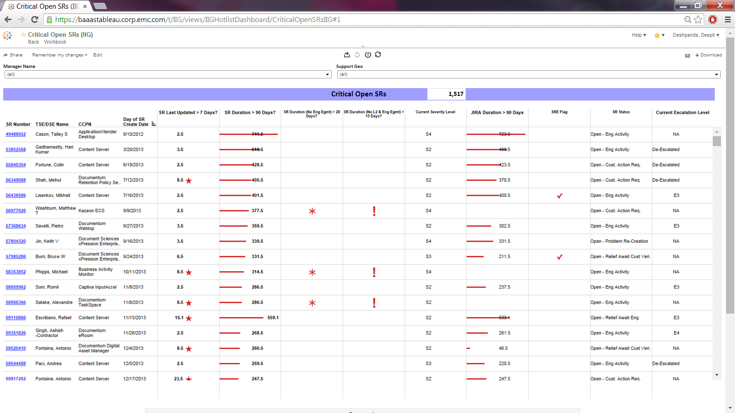
Manager Hotlist Dashboard

Slide 14
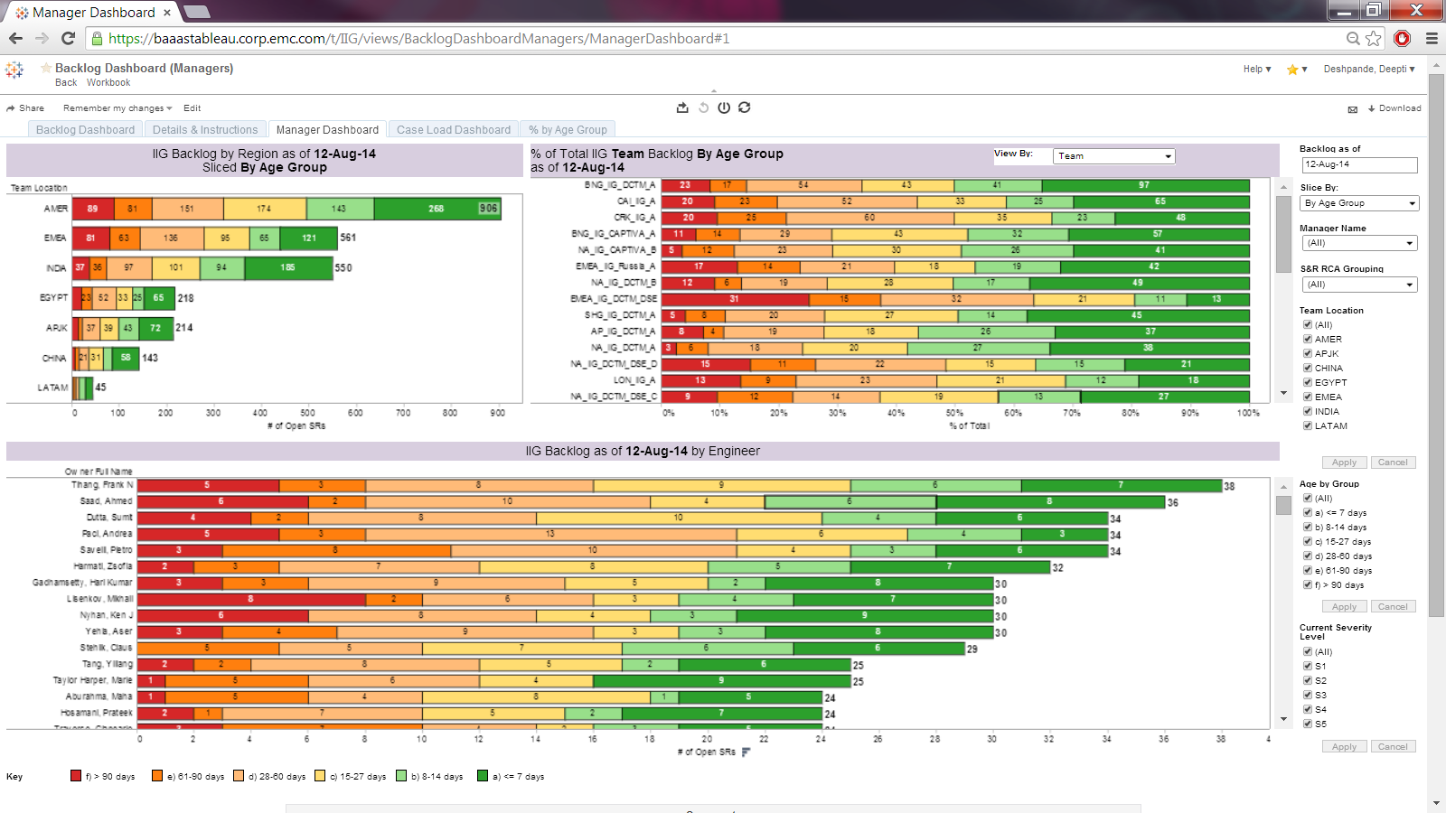
Backlog Manager Dashboard

Slide 15
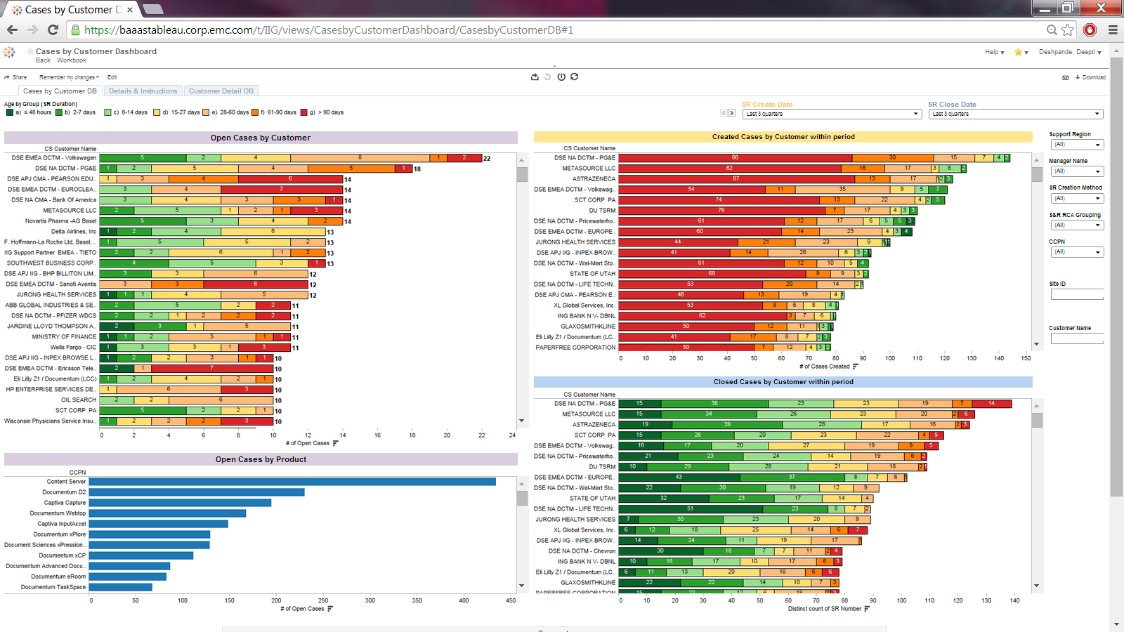
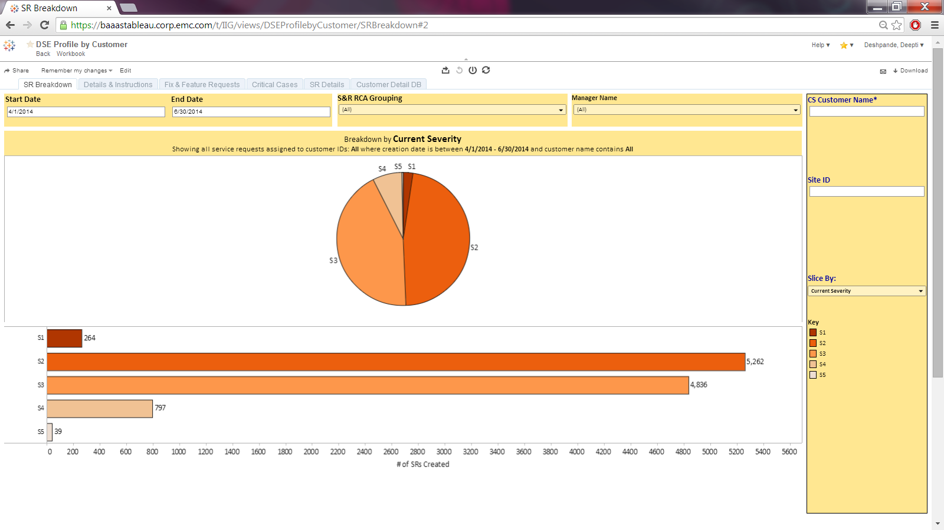
Other Dashboards
Cases by Customer Metrics
DSE Profile by Customer Metrics

Slide 16
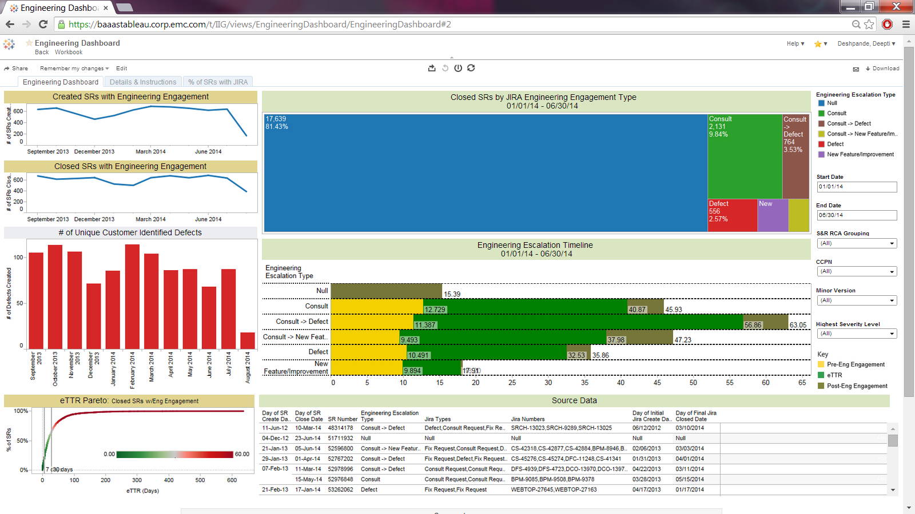
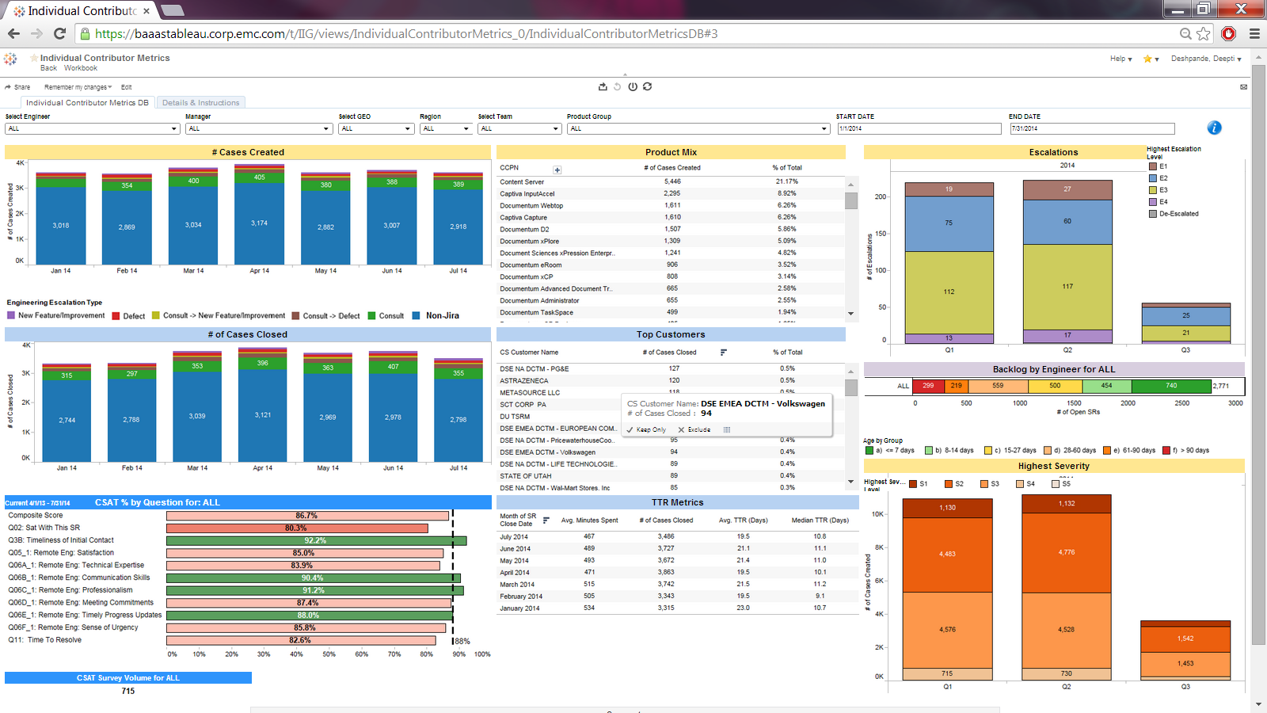
Other Dashboards
Engineering Dashboard
Individual Contributor Metrics

Slide 17
Key Observations/Analysis
Identified loopholes in the workflow of L2 tasks
Identified a bug in the data extracts which was previously being used by the team and corrected it
Identified that there is a need for the queues to be updated

Slide 18
Lessons Learned
Exposed to Data Analytics field in real time environment and learnt the different phases of Data Analytics
  Requirements Collection
  Data Access
  Data Identification
  Data Visualization
  Business Analytics
  Knowledge Transfer
Understood the life cycle of Business operations team
Learnt new technologies like Tableau and Greenplum
Learnt and understood the process of collecting requirements effectively from the customer

Slide 19

Achievements
Received letter of recommendation from the manager stating good work at EMC Corporation
Received “exceeds expectations” performance appraisal during my stint at EMC Corporation as Summer Intern

Slide 20
Questions?

